Slide 1


DATA CASE STUDY
Netflix Content Strategy:
Data Exploration & Visualization
An end-to-end EDA of Netflix's global content catalogue — cleaning, univariate and bivariate analysis, and outlier checks — turned into business insights on content strategy across markets.
8,807 TITLES
12 ATTRIBUTES
11 VISUAL ANALYSES
TOOLS USED
Python
NumPy
Pandas
Matplotlib
Seaborn
Prakhar Shukla
linkedin.com/in/prakhar-shukla-ds
github.com/prakhar-shukla-ds

Slide 2
THE DATASET
A Global Netflix Content Catalogue
8,807 titles across 12 attributes covering content type, cast, director, country, genre, rating, release year, and platform add date — built for univariate, bivariate, and outlier analysis.
Identity
People
Geography
show_id, type, title
director, cast
country
Platform Timing
Classification
Format
date_added, release_year
rating, listed_in (genre)
duration, description
NETFLIX DATA CASE STUDY
2

Slide 3
THE ROADMAP
11 Analyses, 3 Stages
From single-variable distributions to cross-variable relationships and outlier checks, the analysis builds up through cleaning, visualization, and business interpretation.
UNIVARIATE · 6
BIVARIATE · 3
OUTLIER CHECK · 2
Content Type: Movies vs TV Shows
Distribution of Release Year
Distribution of Movie Duration
Distribution of TV Show Seasons
Content Count by Maturity Rating
Top 10 Countries by Content Count
Movie Duration by Maturity Rating
TV Show Seasons by Maturity Rating
Release Year by Content Type
Outlier Detection: Movie Duration
Outlier Detection: TV Show Seasons
NETFLIX DATA CASE STUDY
3

Slide 4
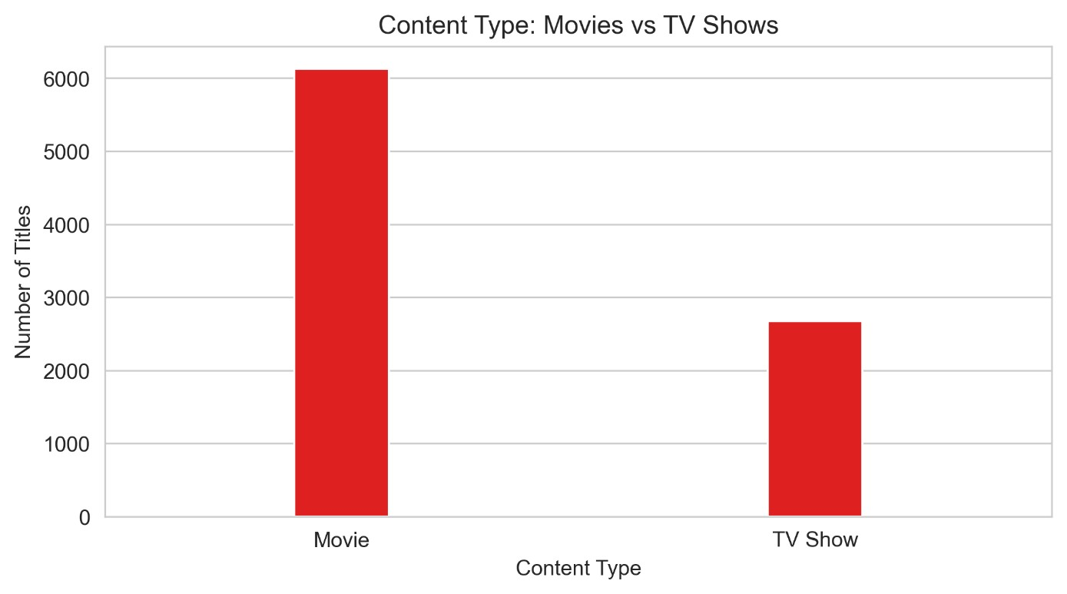
UNIVARIATE
CHART 1 OF 11
Content Type: Movies vs TV Shows
A simple count of titles by type establishes the baseline shape of the catalogue.
RESULT Movies dominate the catalogue — 6,131 titles (69.6%) vs 2,676 TV Shows (30.4%).
APPROACH Counted rows by the type column and plotted Movie vs TV Show as a bar chart to see the overall split.
NETFLIX DATA CASE STUDY
4

Slide 5
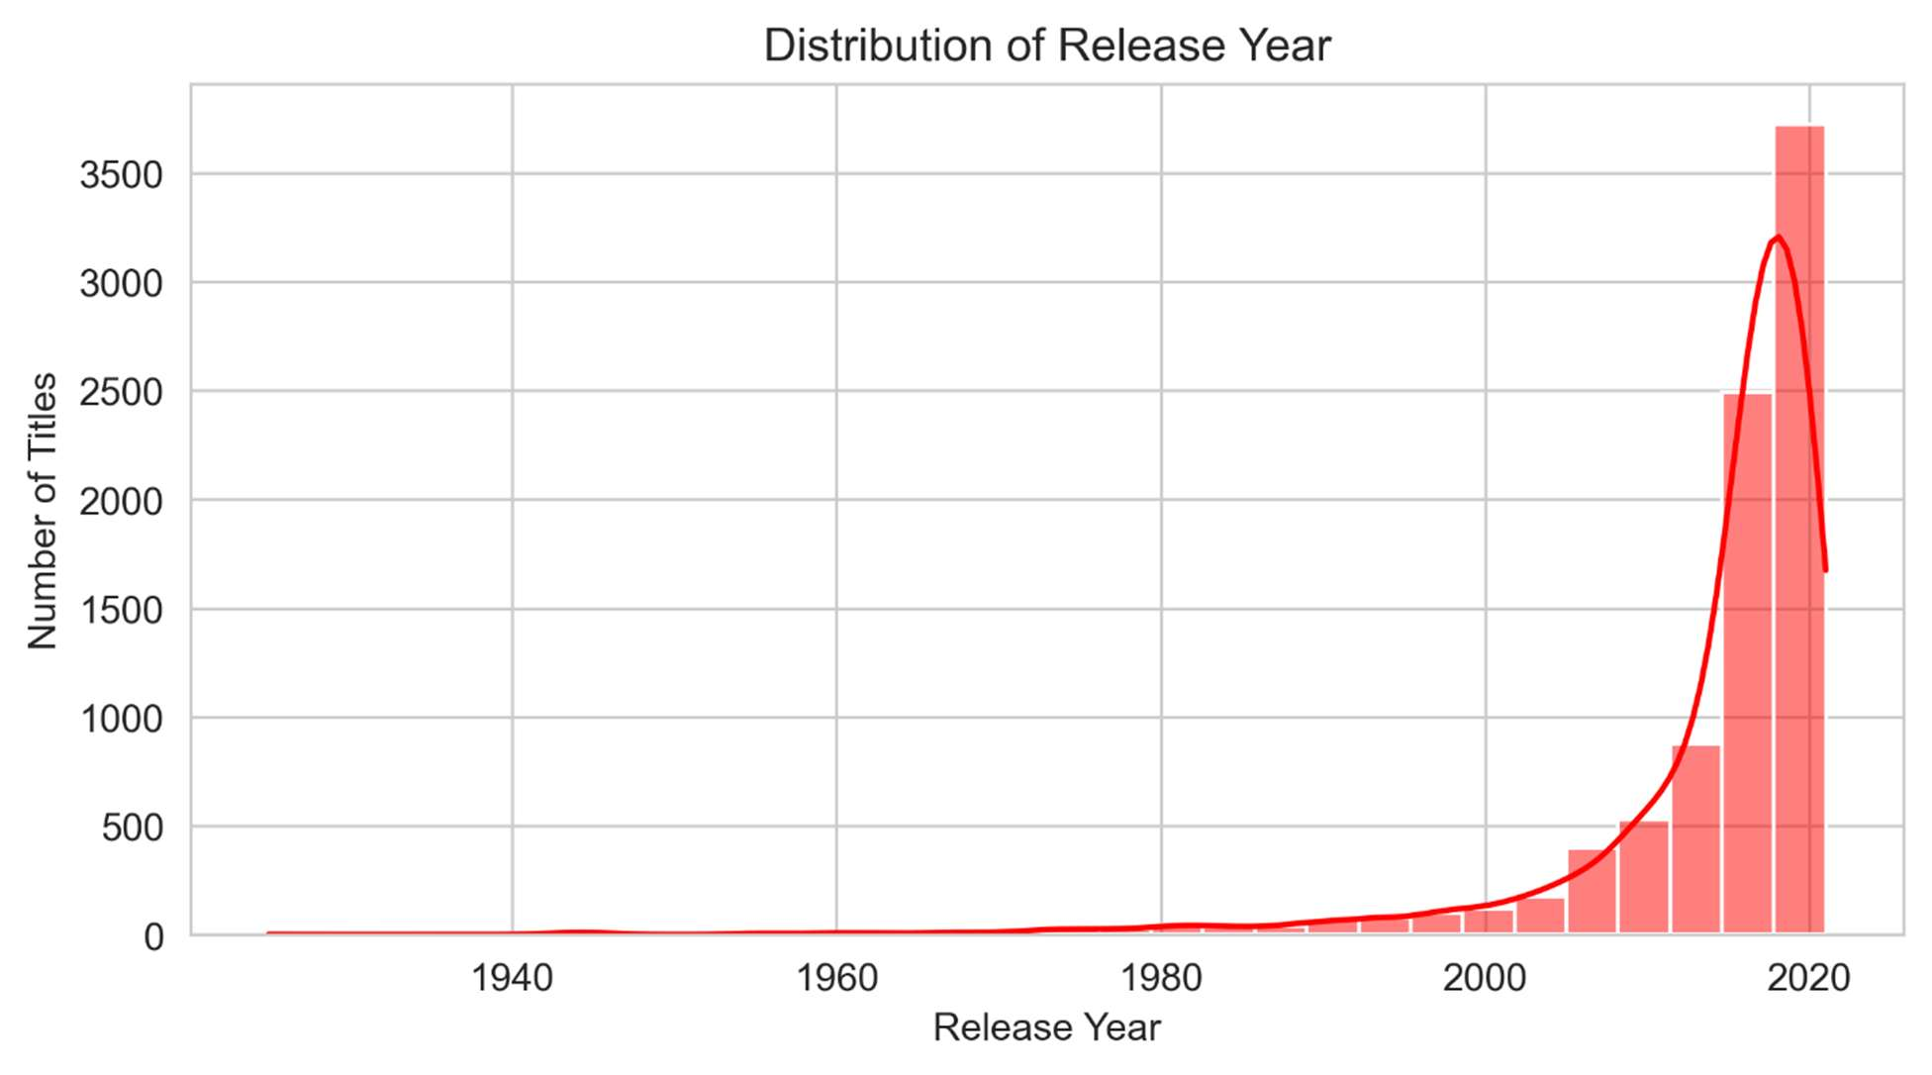
UNIVARIATE
CHART 2 OF 11
Distribution of Release Year
A histogram of release_year shows how old (or new) the catalogue's content is.
RESULT Strongly right-skewed: very few titles before 2000; the median release year is 2017.
APPROACH Plotted a histogram with a KDE overlay on release_year across the full 1925–2021 range.
NETFLIX DATA CASE STUDY
5

Slide 6
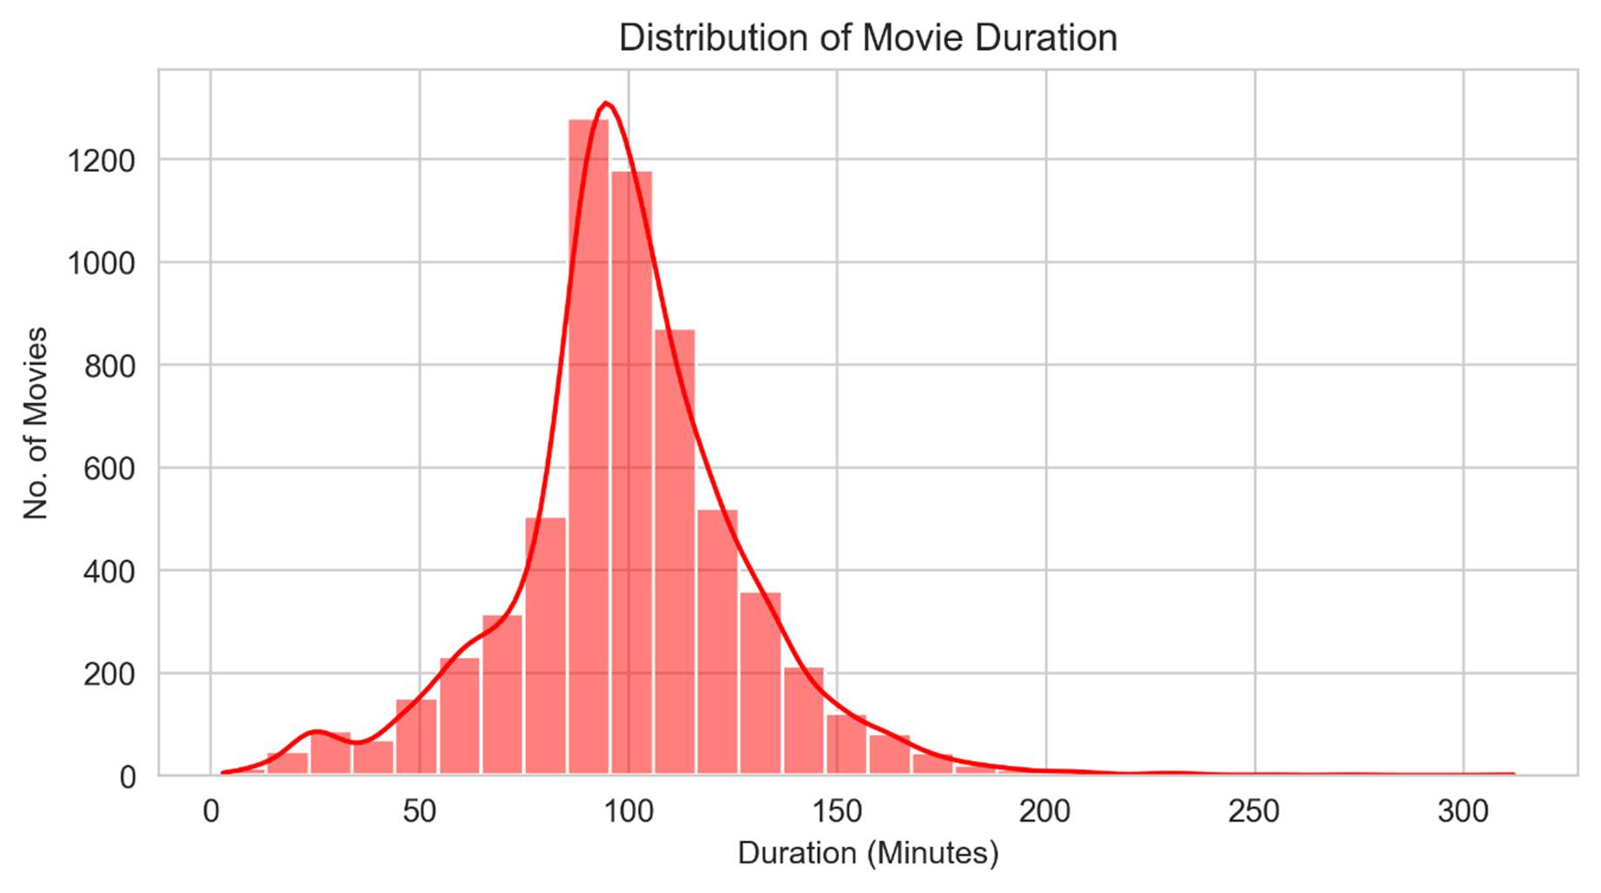
UNIVARIATE
CHART 3 OF 11
Distribution of Movie Duration
Movie runtimes were parsed from the duration column and plotted as a histogram.
RESULT Most movies run 87–114 minutes, centered around ~98 minutes — a standard feature length.
APPROACH Extracted the numeric minute value from duration for rows where type = Movie, then plotted the distribution.
NETFLIX DATA CASE STUDY
6

Slide 7
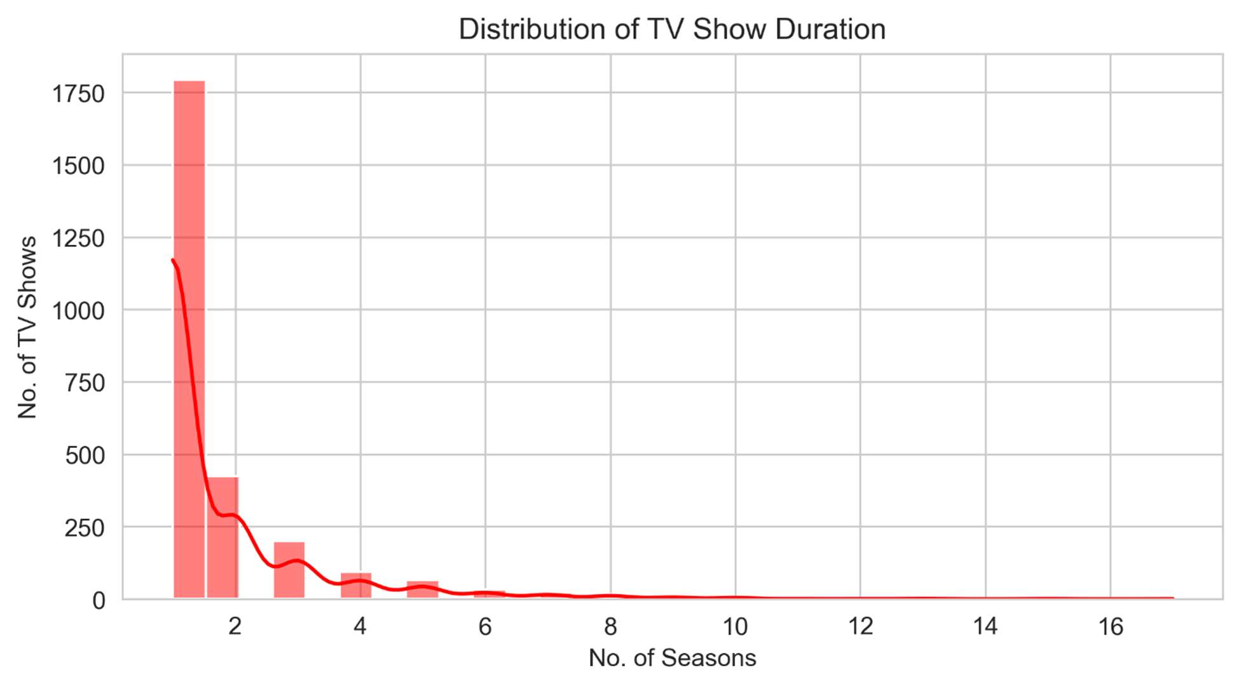
UNIVARIATE
CHART 4 OF 11
Distribution of TV Show Seasons
Season counts were parsed from duration for TV Shows to see renewal patterns.
RESULT About 67% of TV Shows have just 1 season; the longest-running show has 17 seasons.
APPROACH Extracted the season count from duration where type = TV Show and plotted it as a histogram.
NETFLIX DATA CASE STUDY
7

Slide 8
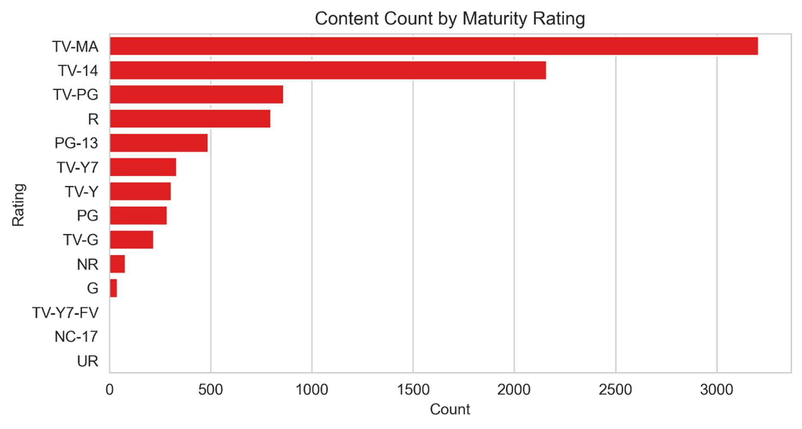
UNIVARIATE
CHART 5 OF 11
Content Count by Maturity Rating
Counting titles by rating reveals which audience segments Netflix serves most.
RESULT TV-MA and TV-14 lead, together making up about 61% of the catalogue.
APPROACH Counted titles per rating category and plotted them as a horizontal bar chart, sorted descending.
NETFLIX DATA CASE STUDY
8

Slide 9
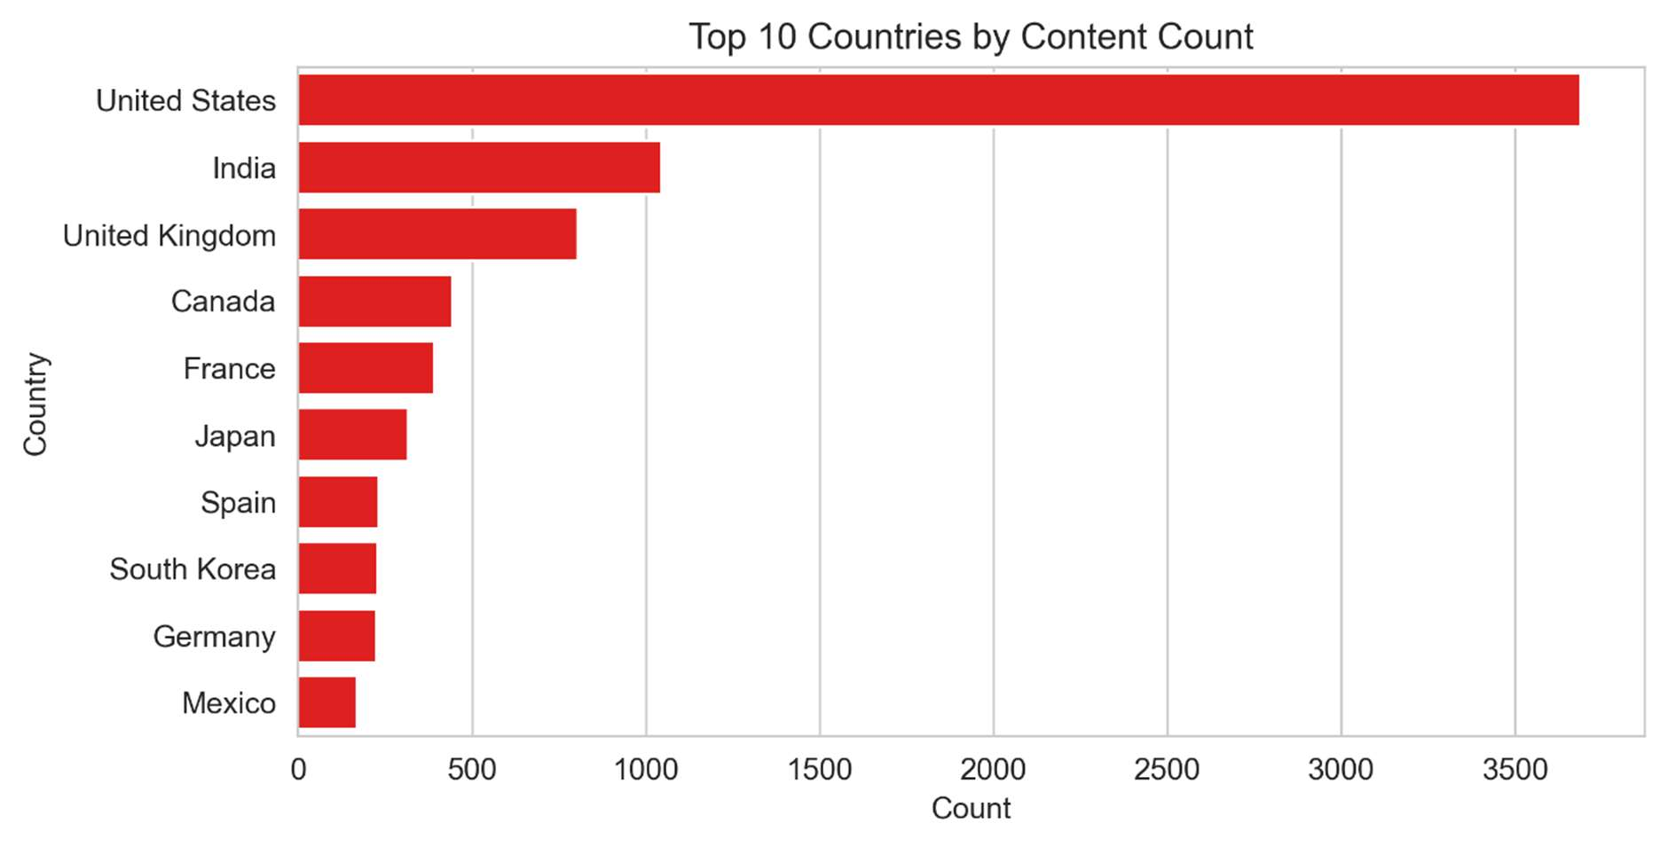
UNIVARIATE
CHART 6 OF 11
Top 10 Countries by Content Count
The country field was unnested (comma-separated) before counting, so co-productions count once per country.
RESULT The United States leads with 3,689 titles, followed by India (1,046) and the UK (804).
APPROACH Split multi-value country strings into one row per country, counted titles per country, and ranked the top 10.
NETFLIX DATA CASE STUDY
9

Slide 10
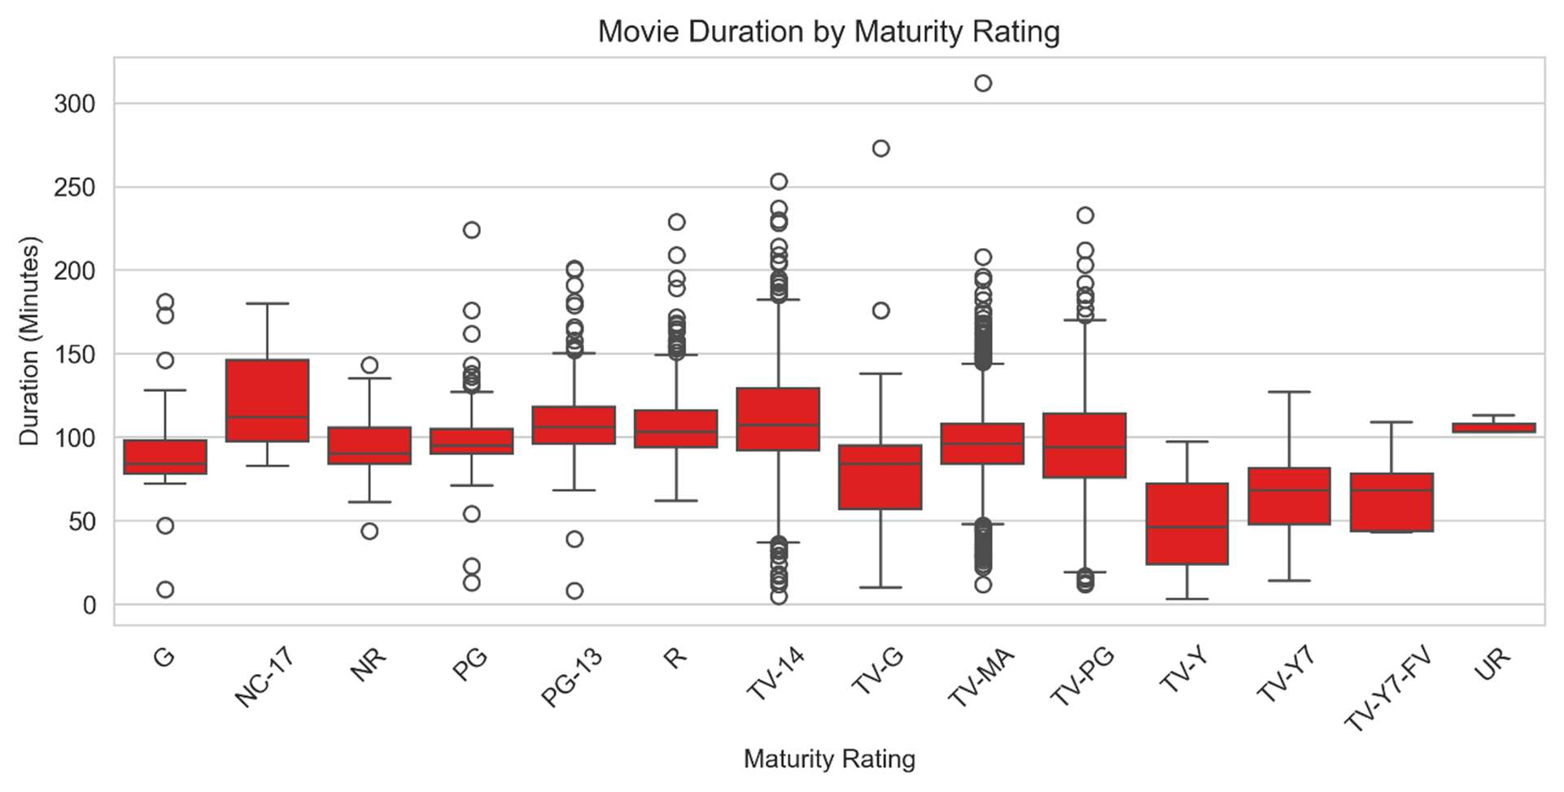
BIVARIATE
CHART 7 OF 11
Movie Duration by Maturity Rating
A boxplot compares runtime distributions across rating categories.
RESULT NC-17 and TV-14 movies run longest on average; TV-PG and PG titles are generally shorter.
APPROACH Grouped movie duration by rating and plotted boxplots to compare medians, spread, and outliers per category.
NETFLIX DATA CASE STUDY
10

Slide 11
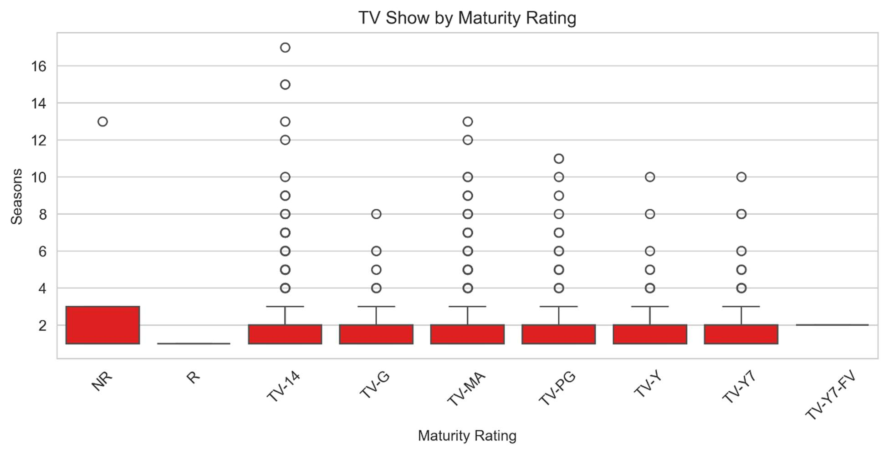
BIVARIATE
CHART 8 OF 11
TV Show Seasons by Maturity Rating
The same boxplot approach applied to season count instead of movie runtime.
RESULT Median is 1 season across almost every rating; TV-MA and TV-14 show the widest spread, including 10+ season runs.
APPROACH Grouped season count by rating and plotted boxplots to surface which ratings sustain long-running series.
NETFLIX DATA CASE STUDY
11

Slide 12
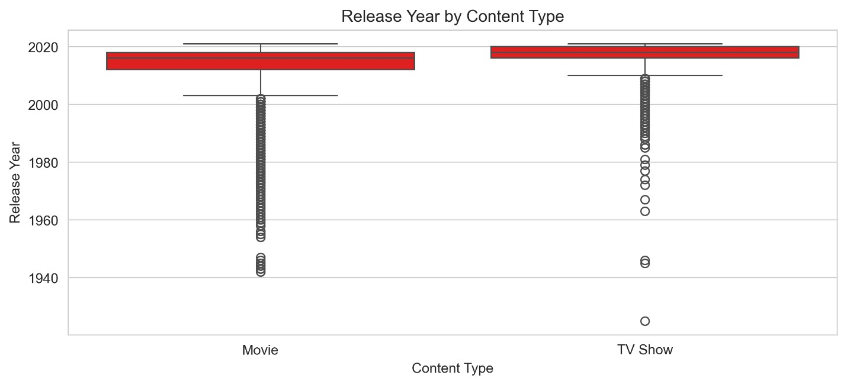
BIVARIATE
CHART 9 OF 11
Release Year by Content Type
Comparing release_year distributions between Movies and TV Shows shows recency by format.
RESULT TV Shows skew slightly more recent (median 2018) than Movies (median 2016).
APPROACH Split release_year by type and plotted side-by-side boxplots to compare medians and spread.
NETFLIX DATA CASE STUDY
12

Slide 13
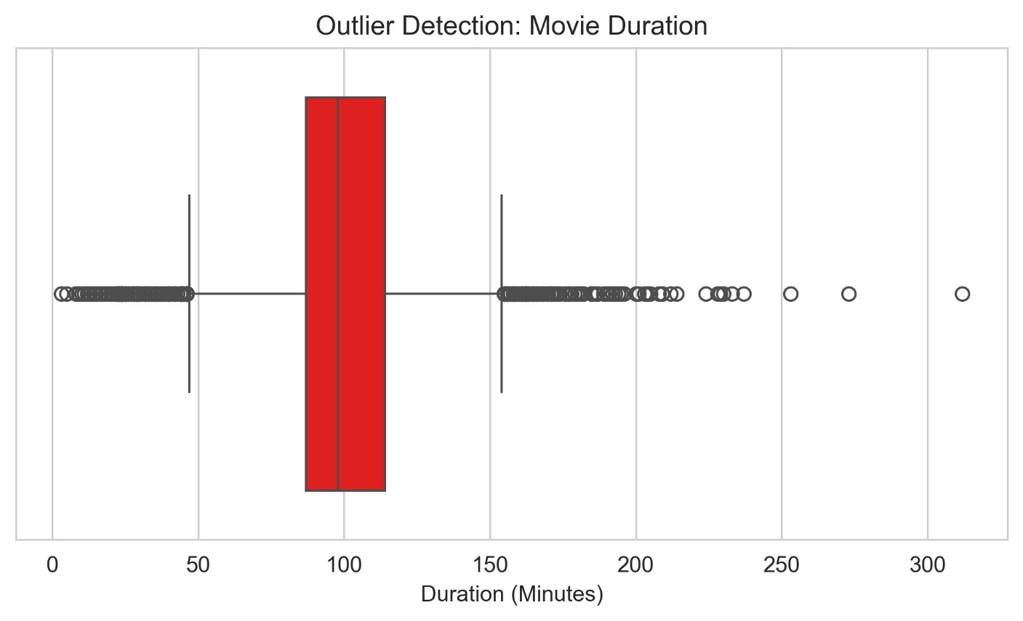
OUTLIER CHECK
CHART 10 OF 11
Outlier Detection: Movie Duration
A boxplot on movie runtime flags unusually short or long titles beyond the IQR whiskers.
RESULT A handful of movies exceed 250 minutes — rare specials or epics rather than the norm; these were kept, not removed.
APPROACH Plotted a horizontal boxplot on movie duration and visually inspected points beyond the whiskers as candidate outliers.
NETFLIX DATA CASE STUDY
13

Slide 14
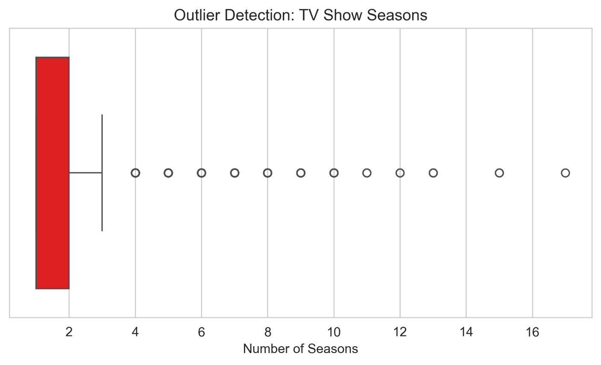
OUTLIER CHECK
CHART 11 OF 11
Outlier Detection: TV Show Seasons
The same outlier check applied to season count for TV Shows.
RESULT A small number of long-running series (up to 17 seasons) sit well beyond the whiskers — valid data, not errors.
APPROACH Plotted a boxplot on season count; confirmed high-season outliers were genuine long-running shows and retained them.
NETFLIX DATA CASE STUDY
14

Slide 15
Key Business Insights
1
Movies still dominate, but TV Shows are gaining ground.
2
Long-running series are the exception, not the rule.
TV Show additions grew from 25% to 33.7% of new titles between 2018 and 2021, while Movie additions declined after 2020.
About 67% of TV Shows have just one season, and long-running shows (4+ seasons) are concentrated in the TV-MA and TV-14 ratings.
3
Content preferences vary sharply by country.
4
The catalogue is concentrated in a few markets and genres.
South Korea and Japan lean toward TV Shows, while India and Germany lean toward Movies — a case for market-specific content strategy.
The US and India account for a disproportionate share of titles, and Drama, Comedy, and International content dominate the genre mix.
NETFLIX DATA CASE STUDY
15

Slide 16
NEXT STEPS
Key Recommendations
✓
Increase investment in TV Shows.
✓
Expand family-friendly content.
Their share of new additions is growing and they drive longer viewer engagement than one-off movies.
The catalogue skews heavily toward TV-MA and TV-14; broadening PG/TV-Y content can widen the audience base.
✓
Tailor content strategy by country.
✓
Prioritize high-quality limited series.
Grow TV Show investment in South Korea and Japan; continue strong Movie investment in India and Germany.
Since most shows run one season, focused limited series can attract viewers at lower long-term production cost.
✓
Time major releases for July and December.
✓
Diversify beyond the top markets and genres.
These months see the highest historical content additions and likely audience activity.
Invest in underrepresented countries and genres to broaden reach and reduce concentration risk.
NETFLIX DATA CASE STUDY
16

Slide 17
THANK YOU.
Prakhar Shukla

